Slide 2
EXAMPLE OF FINDING POSTERIOR PROABILITY USING WATER FALL DIAGRAM, NOT THE FORMULA FOR BAYES’ THEOREM

Slide 3
Example of Using Waterfall diagram:
1000 women, each 40 years old go in for screening
Prevalence is 1 % so 990 are healthy , 10 of them actually have cancer
Out of 10 cases having cancer, recall rate is 80% so 8 cases (TP=8) are detected, 2 are missed (FN)
since FPR is 10%, 100 out of 1000 are FP(=100) , so 890 (990-100) are cleared (TN=890 )
So total positive cases are TP+FP=8+100=108

Slide 4
Calculate Pr(C/P) and Pr(NC/P) using Bayes’s Theorem

Slide 5
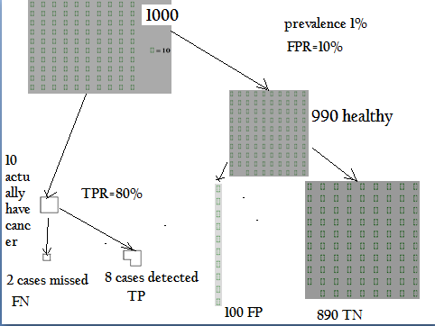

Slide 6
Calculate Pr(C/P) and Pr(NC/P) using WaterFall Diagram
Pr(C/P)
Of these 108 positive mammograms, 8 are real cancer cases, while 100 are FP
Therefore posterior probability that Alice has cancer P(cancer/positive mammogram) , is about (8/108)x100 approximately 7.4% Pr(C/P)
What about Pr(NC/P)
Out of 108 P cases 100(FP) are healthy
Pr(NC/P)= (100/108)x100=92.5%
That is Bayes’s Rule.

Slide 7
Why most of the doctors were away by factor of 10 ??
Doctors were ignoring the prior probabilty, a fallacy called “base rate neglect”.
Do not ask your doctor “How accurate is this test?” Instead ask”What is the posterior probability that I have the disease?” ( be prepared for a scowl, since your doctor may not know what this is)

